Slide 1
Annual Title I Parent Meeting
Lathrop Intermediate School

Slide 2
Title I Annual Meeting
The purpose of this meeting is to inform parents of Lathrop’s participation in the Title I program and to explain the Title I, Part A requirements and the right of parents to be involved in those programs.

Slide 3
What Is Title I?
Title I is the United States Federal Government’s largest education program to support public schools.
The Purpose:
To help disadvantaged children receive a high quality education and to achieve the high academic standards set by the State of California.

Slide 4
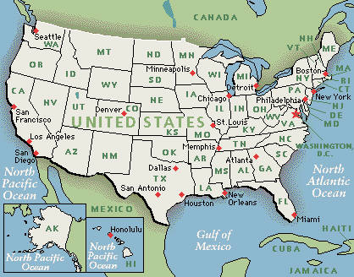
How Is Title I Funded?
The U.S. Department of Education gives a share of Title I funds to each state based on the percentage of poverty in the state.

Slide 5
How Is Title I Funded?
CA distributes the money to school districts based on need.
Districts distribute the money to schools based on the needs of each school.
Each school decides how Title I funds will be used to improve education for students.

Slide 6
How Are Title I Funds Used at Our School?
First: A leadership team reviews data and determines our greatest needs.
Second: The School Site Council (SSC) devises a plan (SPSA) with specific goals to improve student achievement.
Third: SSC decides how Title I funds will be used to support student achievement.
Fourth: SSC monitors and implements the SPSA and makes necessary changes.

Slide 7
Assessments Used to Measure Progress
The following assessments are used to measure student progress:
MAP testing three times a year
District Writing Assessment, ELPAC, SBAC, Physical Fitness, other content area assessments

Slide 8
Title I Programs at Our School
The following programs/supports supplement the instruction of struggling students:
iLit reading intervention programs
Computer repairs
Community & Family Liaison
Supplemental school supplies
Socio-economic programs
Parent programs/learning conferences

Slide 9
Title I Programs at Our School
The following programs support the development of a positive school culture and the socio-emotional well-being of our students:
Ambassadors of Compassion, Girls Inc., Phoenix House, Restorative Practices, Conexiones

Slide 10
Parent Involvement
Parents are an important part of the educational process.
Children are more successful when parents are involved in their children’s education.
Parent involvement in the planning of key initiatives is valued and important.

Slide 11
Parent Involvement Policy
Each school must develop, jointly with parents of children participating in Title I, a written Parent Involvement Policy that describes how the school will engage and support parents in their child’s education - including the development of a Student-Parent-Teacher-Administrator Agreement.
The policy is a promise to parents.
The agreement is a promise to each other.

Slide 12
Student-Parent-Teacher-Administrator Agreement
A promise from all stakeholders to commit to the academic achievement of students.
Must be annually reviewed with the input of parents and revised if necessary.
SSC approves the Parent Involvement Policy and Student-Parent-Teacher-Administrator Agreement annually.

Slide 13
How Can Parents Get Involved in Our School?
SSC/ SPSA development
ELAC/ DELAC input
Parent meetings
Parenting classes
Parent volunteers
Monthly food bank

Slide 14
The SSC and the SPSA
The SSC is a leadership group of teachers, parents, administrators, students and other stakeholders that is responsible for developing the Single Plan for Student Achievement (SPSA).
Developed from an analysis of student achievement data
Reviewed annually to determine the effectiveness of current programs

Slide 15
ELAC and DELAC
English Learners Advisory Committee (ELAC)
A group of parents that meet to advise the school on concerns of English Learners.
Two ELAC members represent each school at the District English Learners Advisory Committee (DELAC)

Slide 16
Parent Rights
Parents have the right to:
Be treated with courtesy by all members of the staff.
Participate in meaningful parent-teacher conferences and to discuss the agreement in relation to their child’s achievement.
Request reports about their child’s progress.
Visit schools and classes.

Slide 17
Questions and Answers
For more information on Title I please contact the EL Programs Department at (714) 558-5855 or contact Cesar Flores at (714) 567-3300 or cesar.flores@sausd.us.

